Slide 1
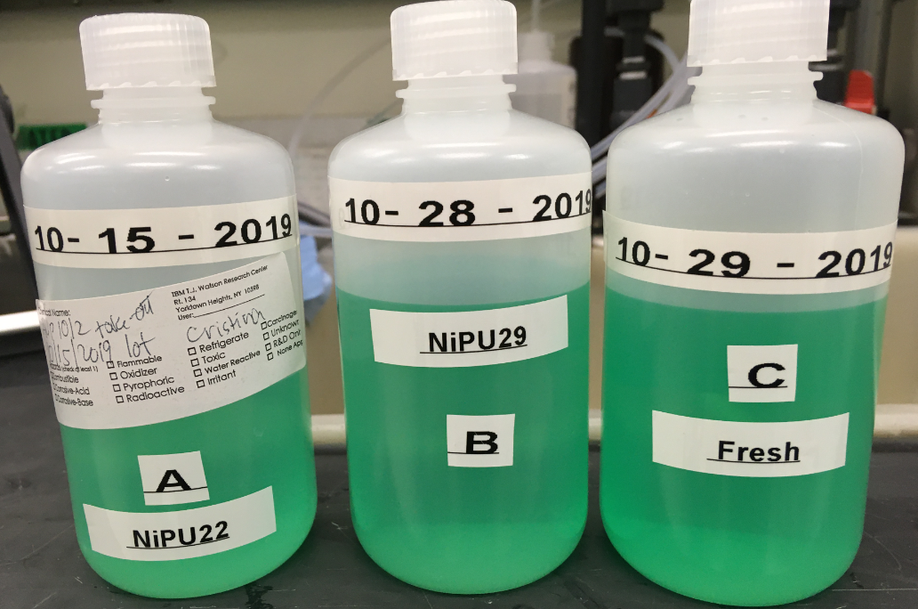
Samples sent for BATH Analysis to Uyemura shipped 11/5/2019
SAMPLES | LOTS processed
A collected on 10/15/2019 bath | STPORA713T30 NiPU 23 | OLD bath before 25% off
B collected on 10/28/2019 bath | STPORA722T36 NiPU 29 | most challenging lot 9 days after 25% off 9 lots processed
C collected on 10/29/2019 bath | STPORA723T39 NiPU30 | fresh

